Slide 1
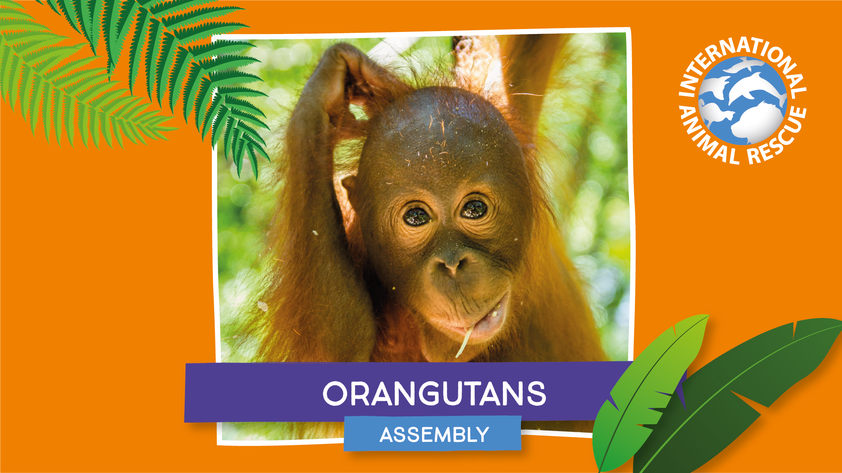

Slide 2
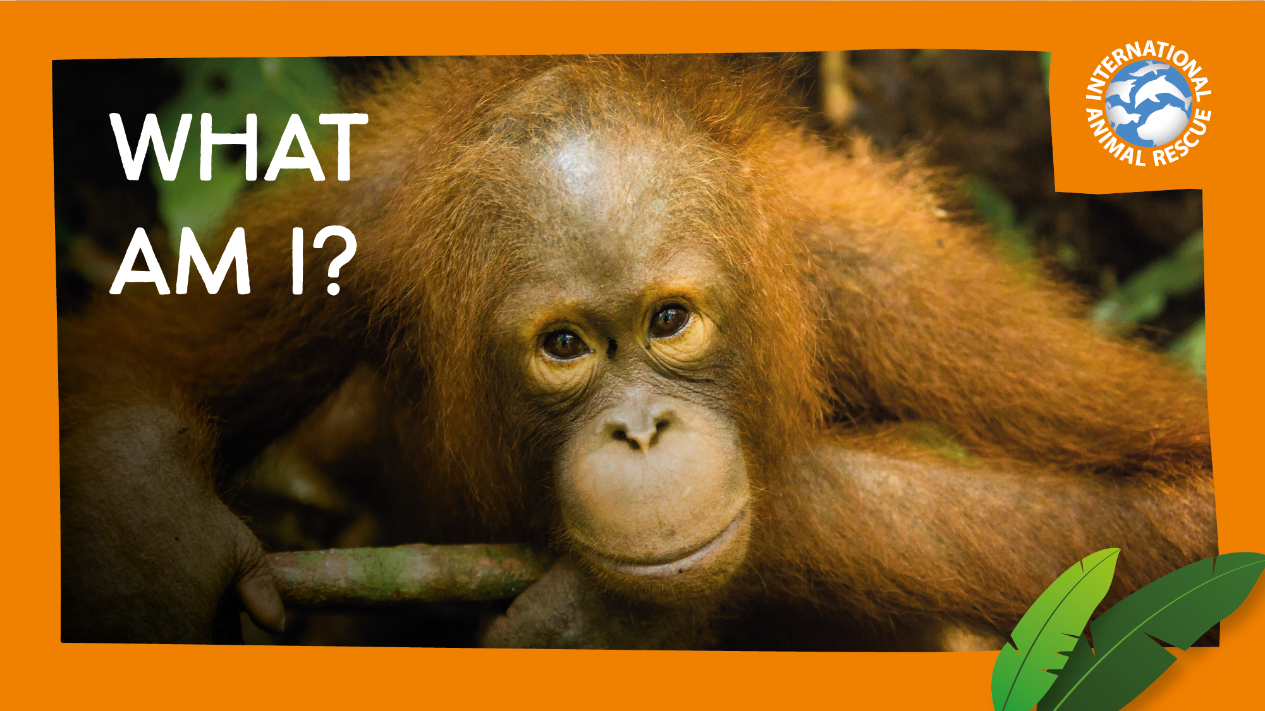
Notes:
What animal is this?
Orangutans are a primate species and one of the species of ‘great apes’ that also include gorillas, chimpanzees – and humans.
They are one of the most intelligent animals. They can communicate with one another, use simple tools and sometimes even enjoy blowing raspberries!

Slide 3
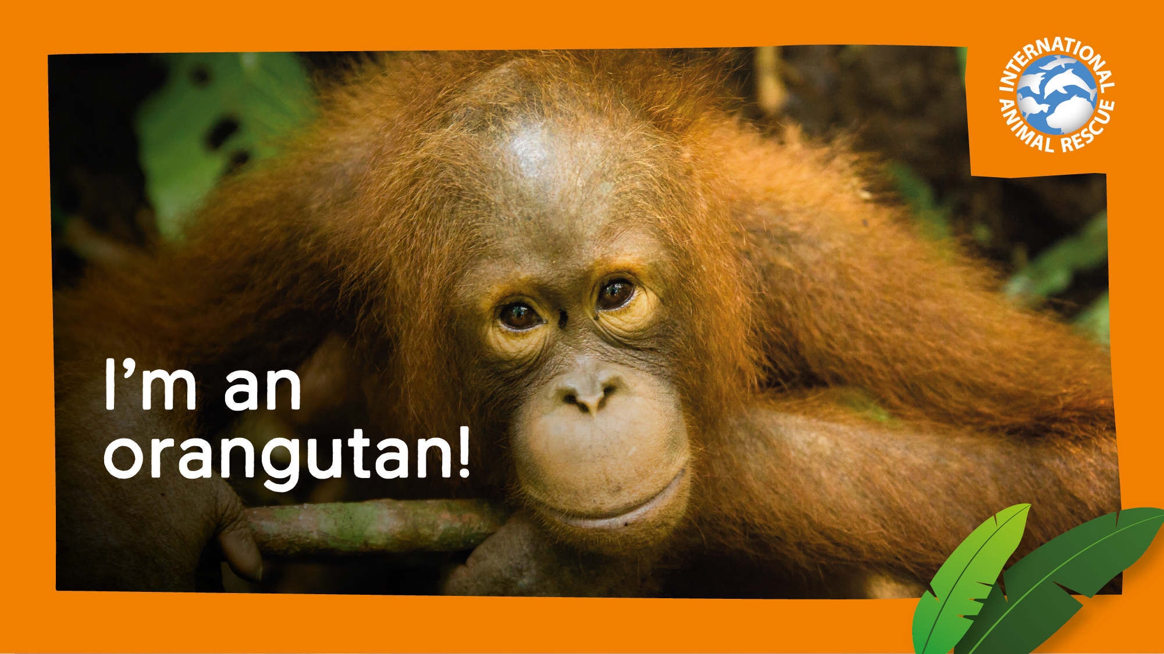
Notes:
What animal is this?
Orangutans are a primate species and one of the species of ‘great apes’ that also include gorillas, chimpanzees – and humans.
They are one of the most intelligent animals. They can communicate with one another, use simple tools and sometimes even enjoy blowing raspberries!

Slide 4

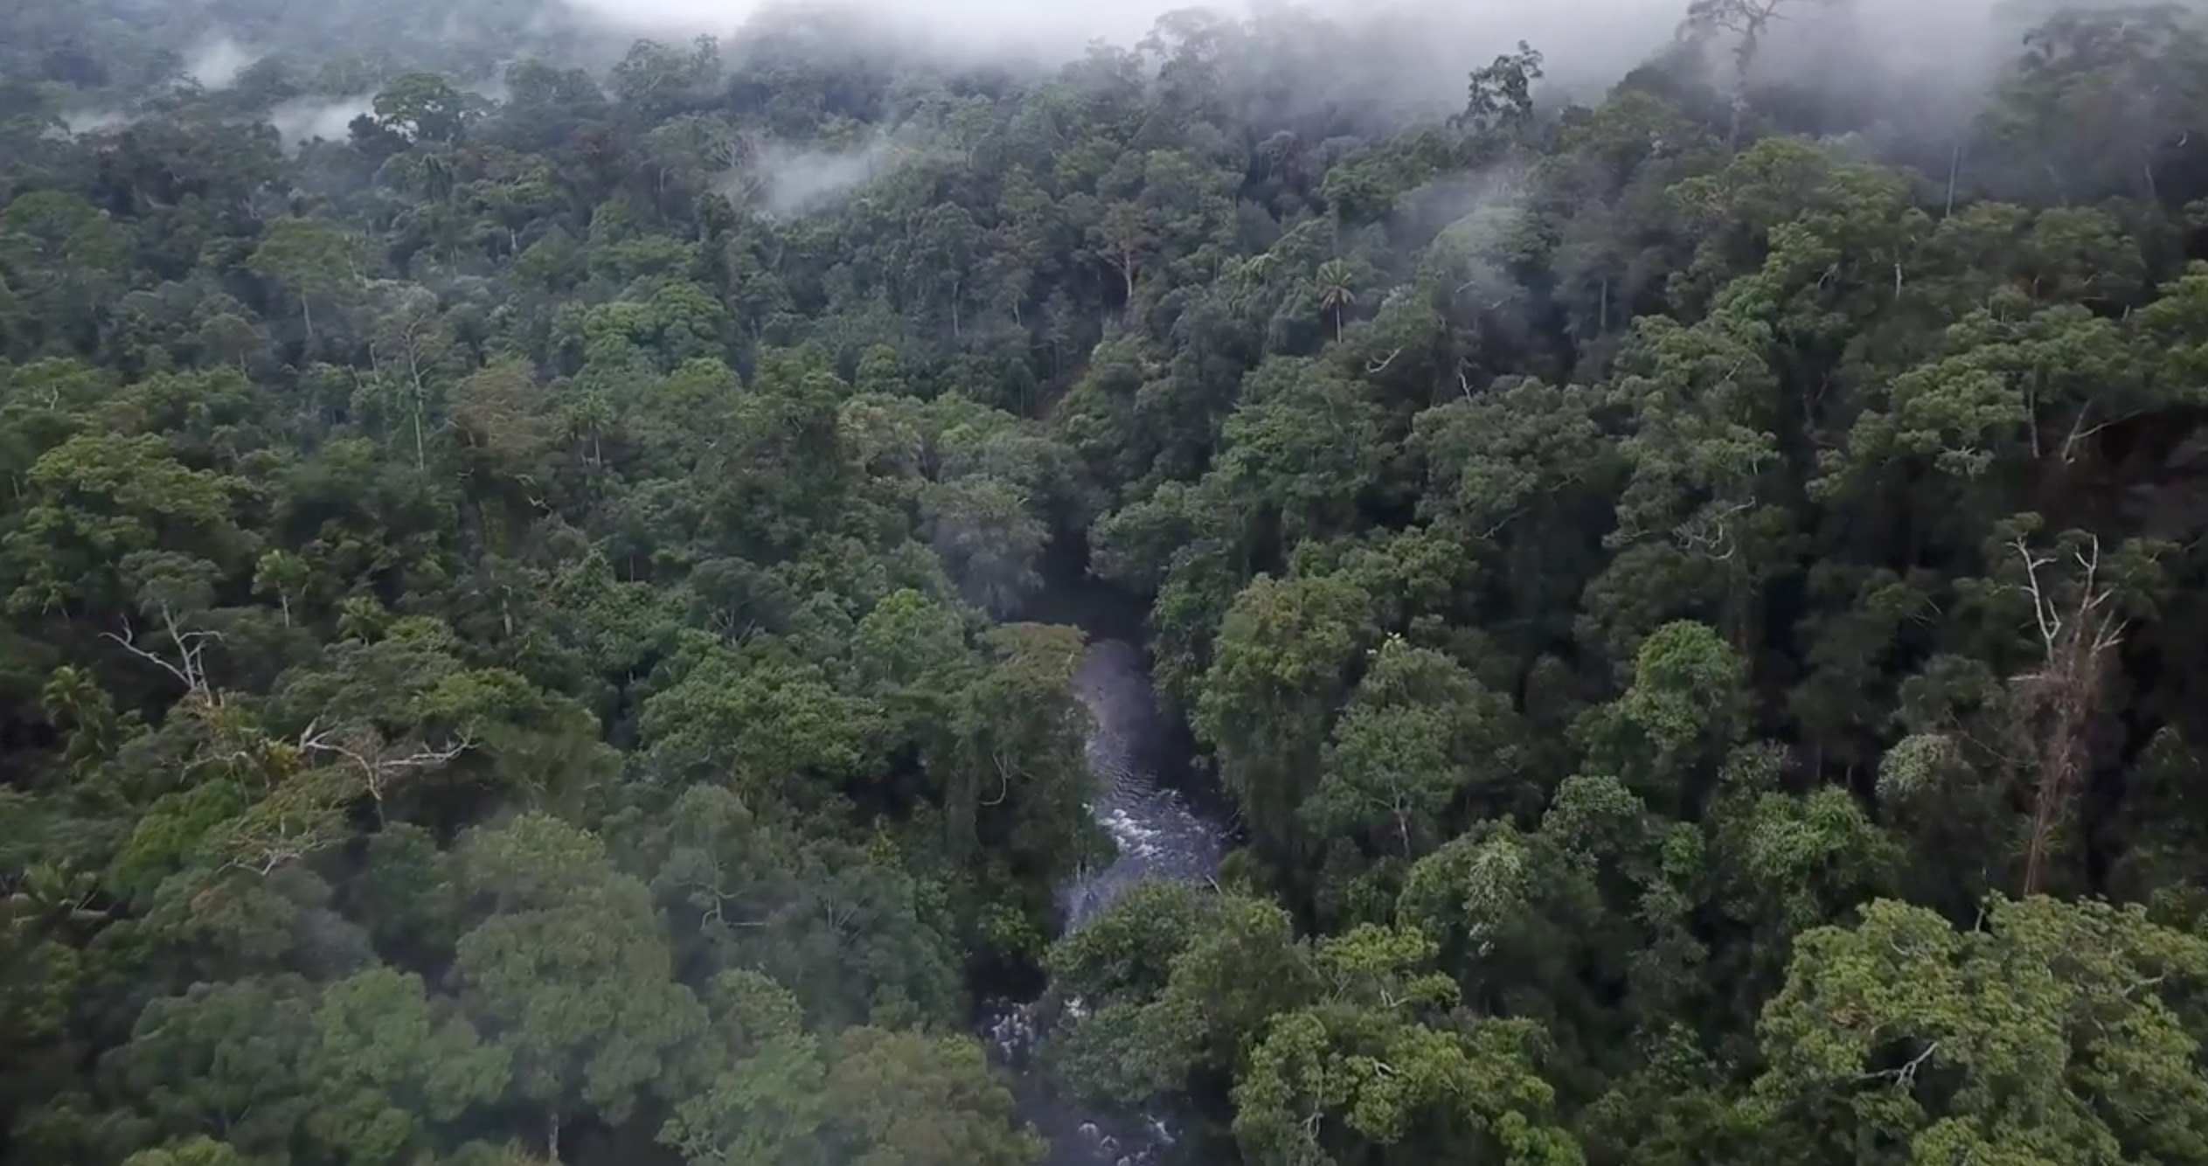
Notes:
Where do you think orangutans live?
Orangutans only live in rainforests on the islands of Sumatra and Borneo, where it is very warm – and very, very wet! Sumatra and Borneo are islands that form part of Indonesia.
Borneo is the third largest island on Earth!
Orangutan means ‘man of the forest’.

Slide 5

Notes:
Where do you think orangutans live?
Orangutans only live in rainforests on the islands of Sumatra and Borneo, where it is very warm – and very, very wet! Sumatra and Borneo are islands that form part of Indonesia.
Borneo is the third largest island on Earth!
Orangutan means ‘man of the forest’.

Slide 6
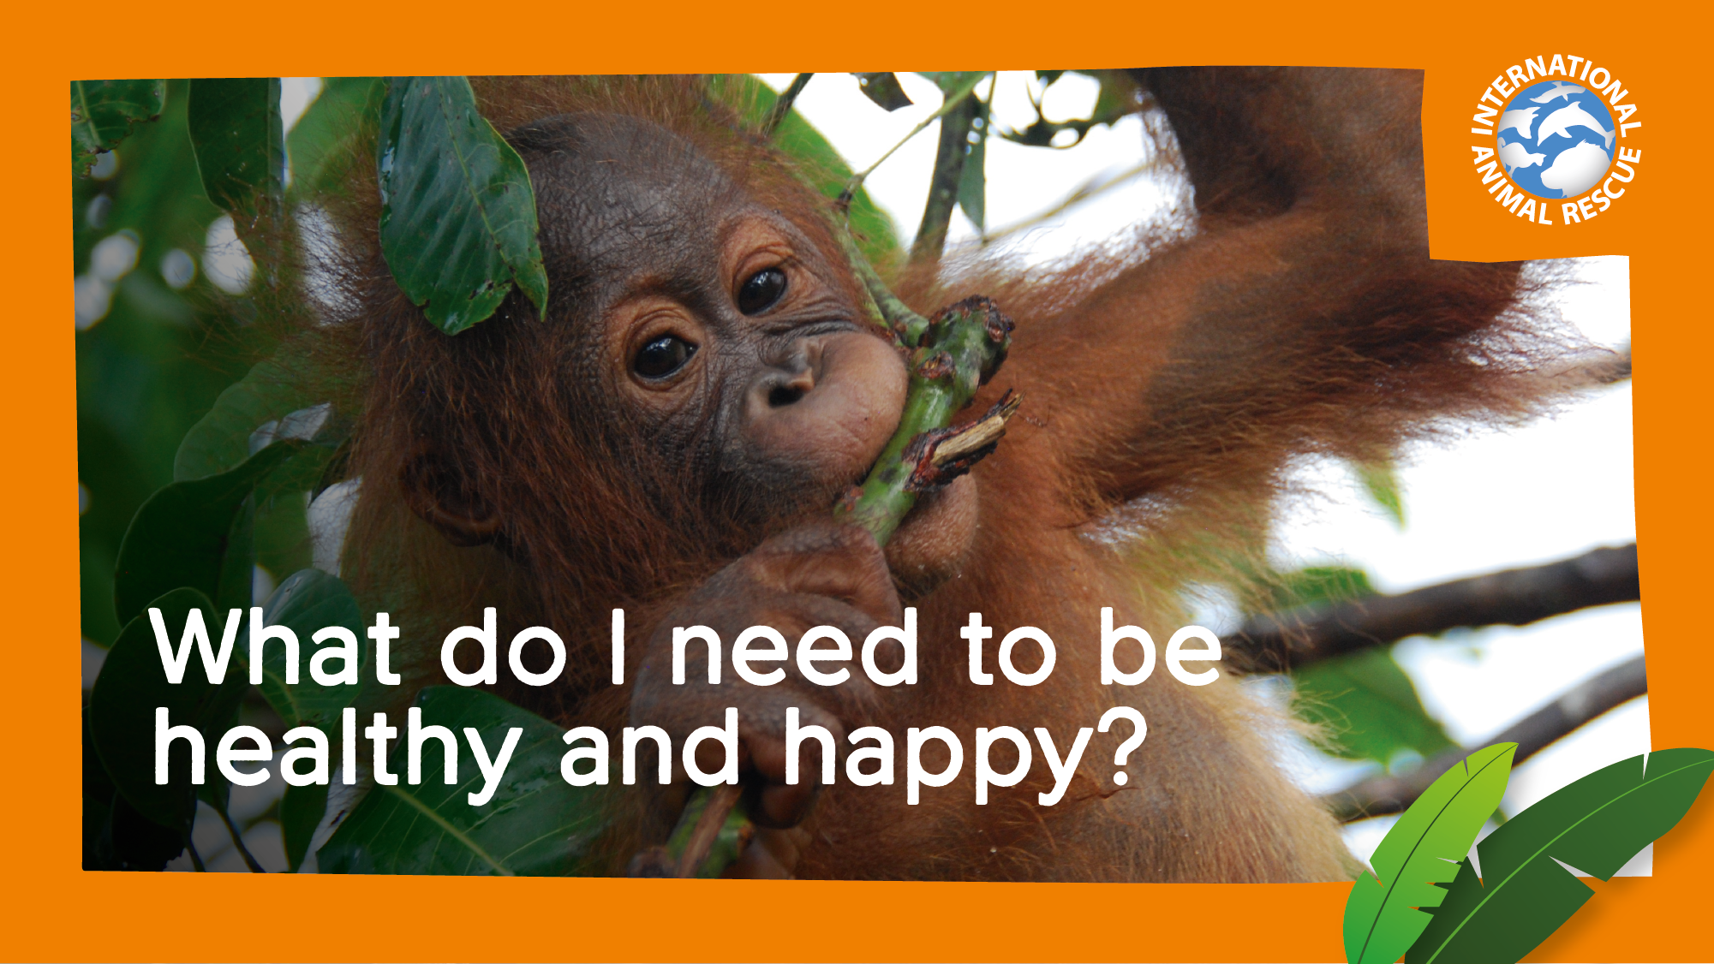
Notes:
Orangutans spend almost all of their time high in the rainforest trees.
What do you think orangutans need, to be healthy and happy?
Just like us, orangutans need food, water, shelter and a safe place to live.
During the day they move from tree to tree searching for fruit to eat.
Where do you think orangutans sleep at night?
They build complicated nests by finding a nice place to stop and then bending branches to form a bed. They sometimes even make a simple roof for their nest.

Slide 7
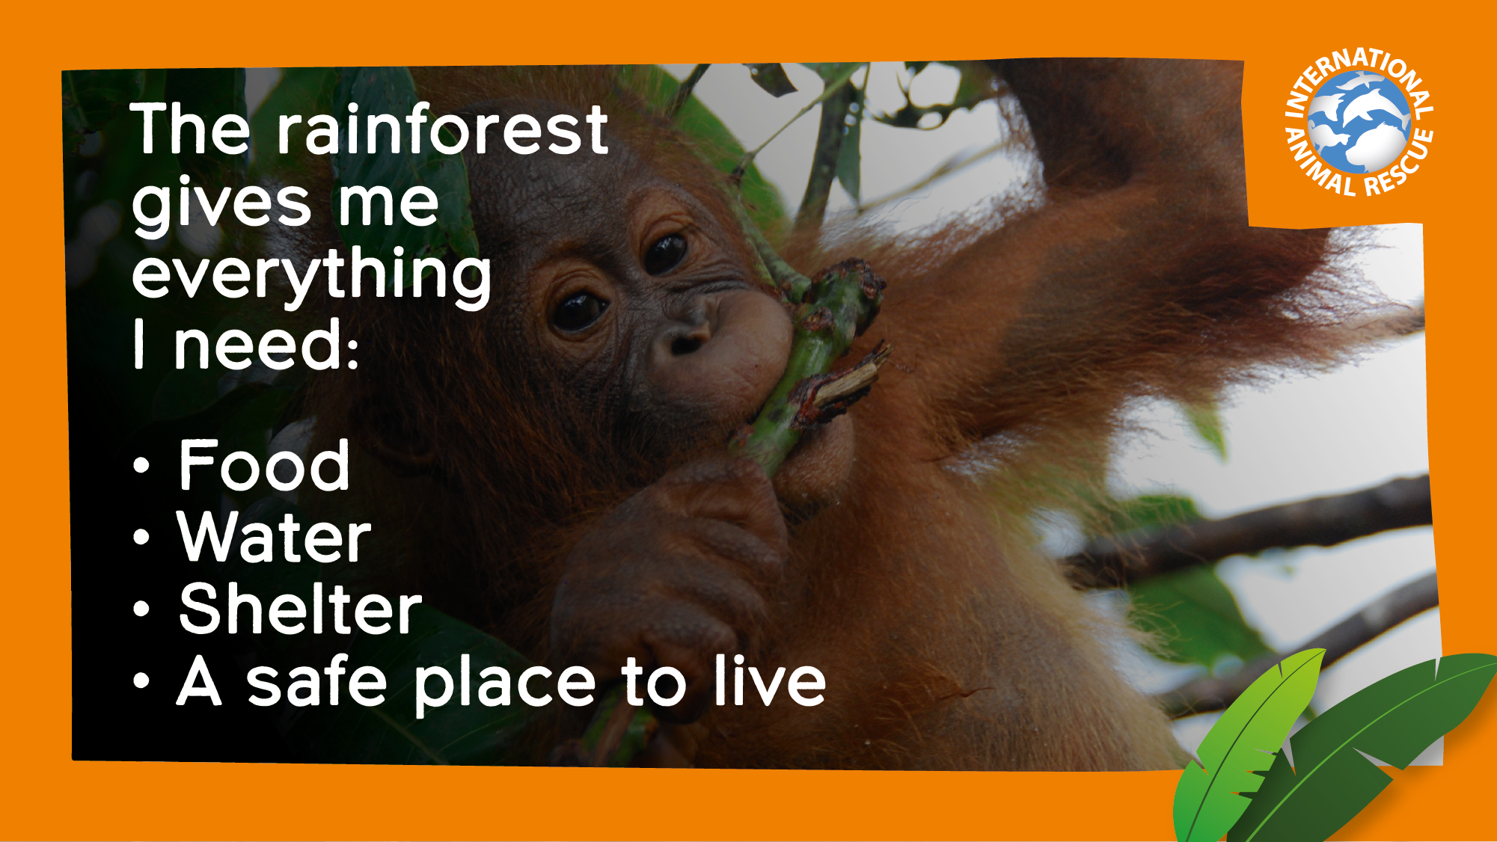
Notes:
Orangutans spend almost all of their time high in the rainforest trees.
What do you think orangutans need, to be healthy and happy?
Just like us, orangutans need food, water, shelter and a safe place to live.
During the day they move from tree to tree searching for fruit to eat.
Where do you think orangutans sleep at night?
They build complicated nests by finding a nice place to stop and then bending branches to form a bed. They sometimes even make a simple roof for their nest.

Slide 8
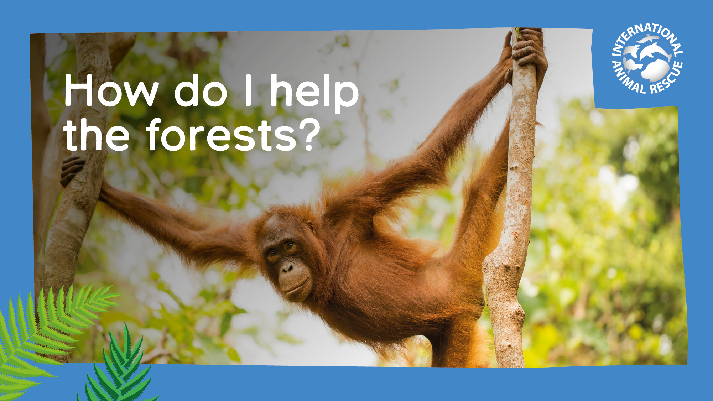
Notes:
While humans like to spend time together, orangutans like to be alone.
They move over a very large area of forest during each day, so each orangutan needs a lot of forest in which to live.
As they move, they eat fruit from the trees they visit.
Can you guess how orangutans help their forest home?
Their droppings contain seeds from the fruit, which fall in new places and grow into more fruit trees.
In this way, orangutans help their forest home to grow and stay healthy.

Slide 9
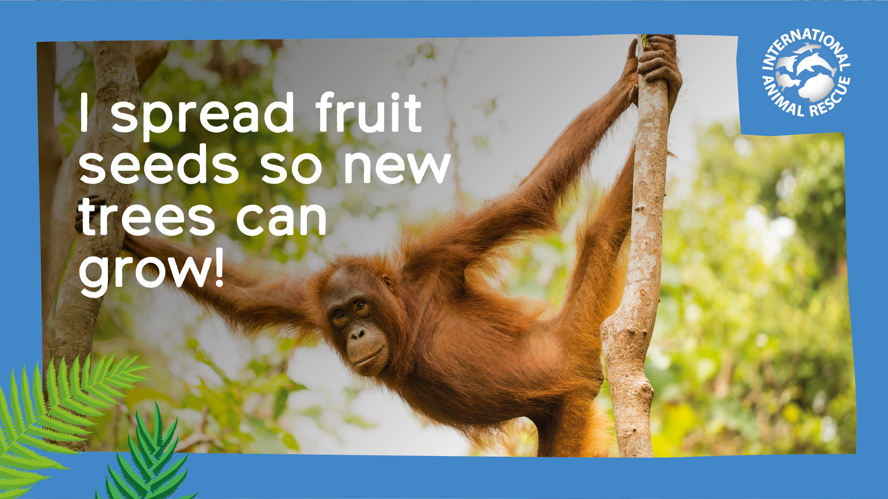

Slide 10

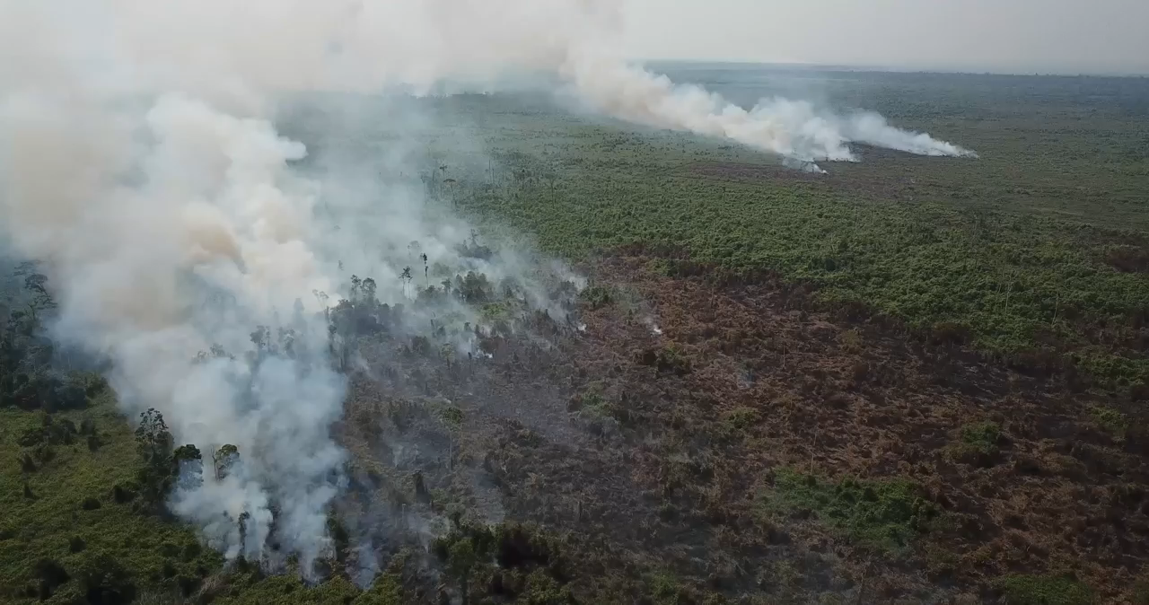
Notes:
What is happening in this video clip?
Who do you think has done this, and why?
The rainforests that are the orangutans’ home are being lost.
They are cut down for illegal logging or to create farmland, or are deliberately burned in forest fires, again to create space for farming.
How do you think this can harm orangutans and other animals that live in the forest?
As the rainforest gets smaller, fewer and fewer orangutans have enough forest in which to live and to be safe, healthy and happy.
So much rainforest has been destroyed that the orangutans in Borneo might not survive.

Slide 11
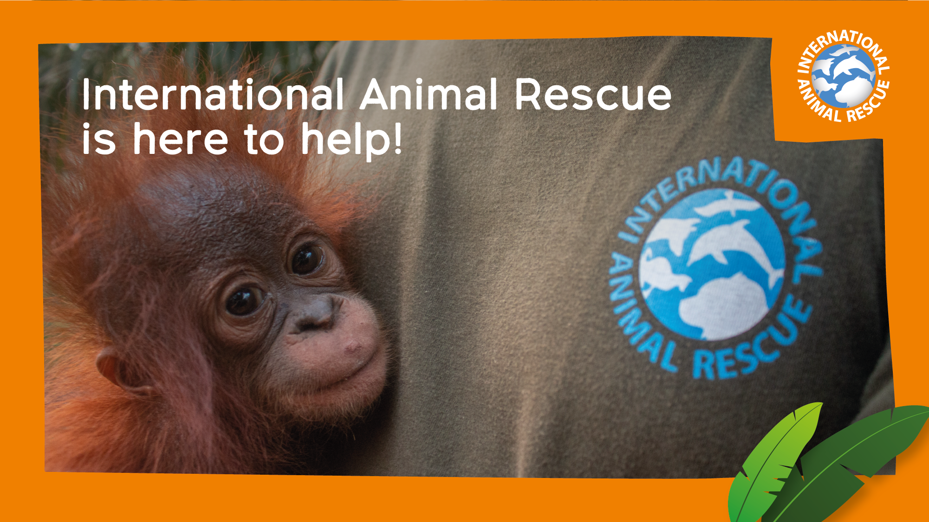
Notes:
International Animal Rescue saves animals from suffering. IAR works around the world to rescue and care for animals that are being harmed, from birds and cats to bears, monkeys and orangutans.
How many orangutans do you think IAR has rescued in Borneo?
Since 2009, IAR has rescued over 200 orangutans in West Borneo.

Slide 12
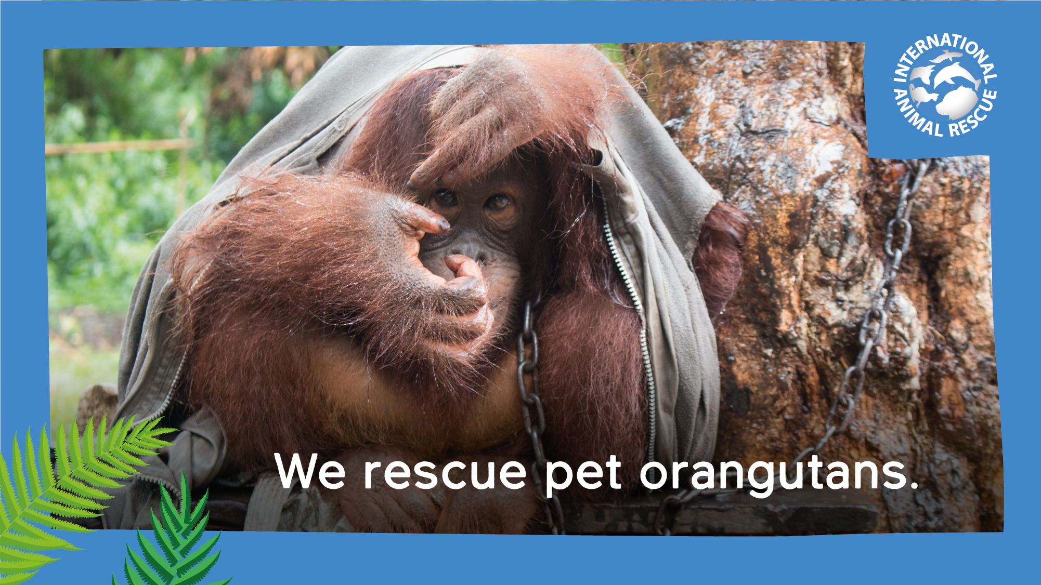
Notes:
What can you see in this picture?
How do you think this young orangutan feels?
It’s illegal, and cruel, to keep an orangutan as a pet. Orangutans are meant to live in the wild, not in a small cage or chained to a tree.
But some people in Indonesia do keep baby orangutans as pets. They are often treated very badly.
Because they are so similar to humans, they can catch human diseases. And like us, they feel pain and sadness.

Slide 13
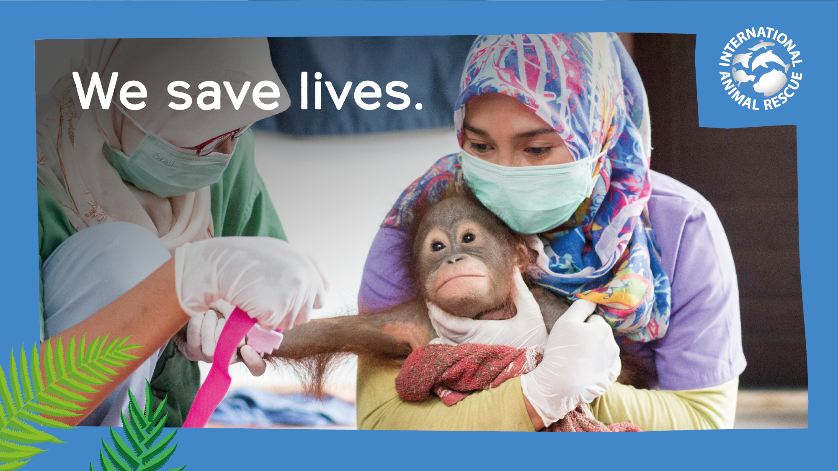
Notes:
What do you think these IAR staff are doing?
When IAR rescues a baby orangutan, they first carefully treat them for any diseases or illnesses they may have.
Then, IAR cares for and feeds them in its special orangutan ‘pre-school’ in a forest enclosure. This is a safe place where they can live with other baby orangutans and get used to life in the forest.

Slide 14
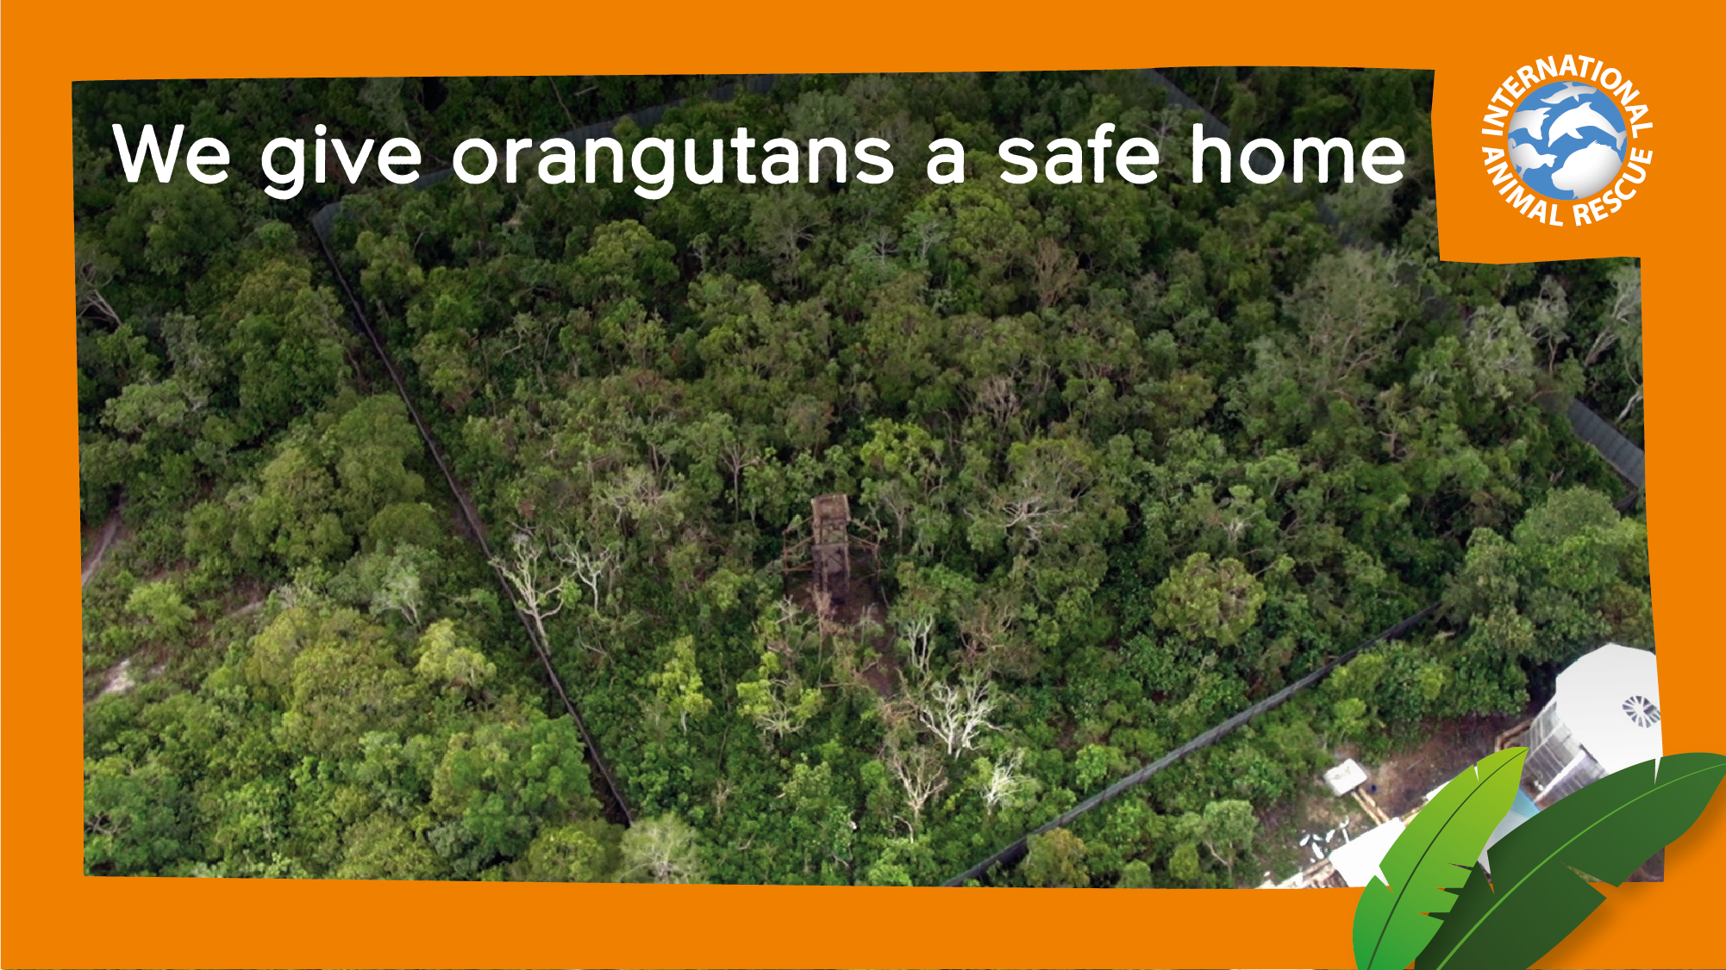
Notes:
What can you see in this picture? (There are some buildings, a large fenced enclosure, and a huge climbing tower. This is IAR’s forest school for orangutans.)
Orangutans that IAR rescues from the rainforest, or who have lived in IAR’s orangutan pre-school, move to its forest school when they are older.
Here, they learn to search for food, make nests and live at night in the forest.
IAR staff watch them carefully and decide which orangutans are ready to be released back into the wild, into safe areas of rainforest.

Slide 15
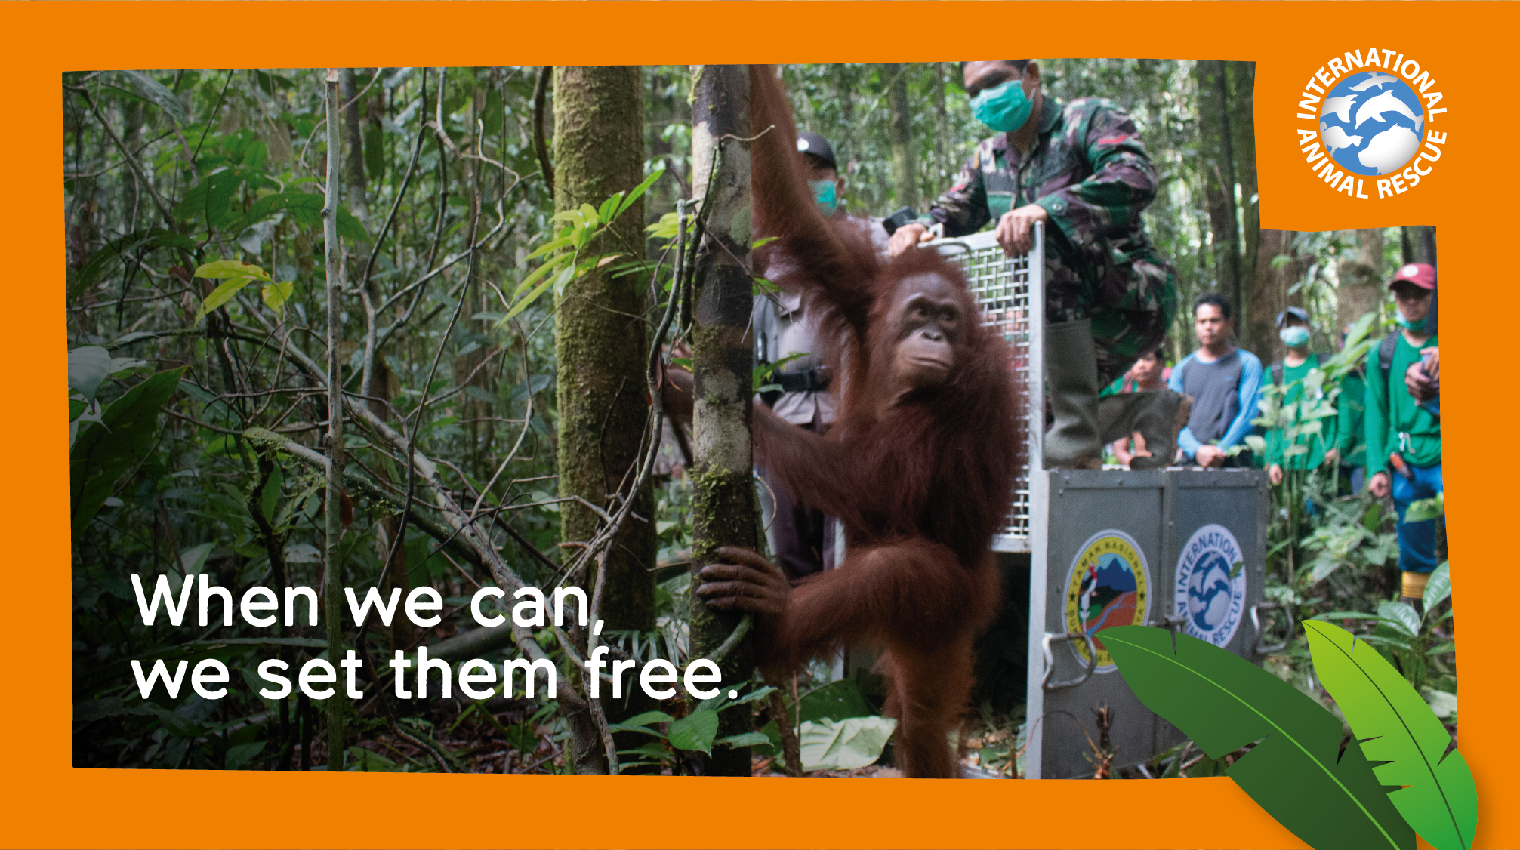
Notes:
What is happening here?
How do you think this orangutan feels, to be free in the rainforest again?
When IAR is certain that an orangutan is ready to live in the rainforest again, they are taken to an area of forest that is safe from logging or farming.
Just like pet dogs and cats in the UK, each orangutan is fitted with a tiny microchip so that if found again, IAR can identify it.
IAR keeps an eye on these orangutans, to make sure they stay safe and well, and to make sure that it is always looking after orangutans in the best possible way.
Some orangutans are never able to return to the rainforest. These orangutans will always have a safe place to live in IAR’s forest enclosures.

Slide 16
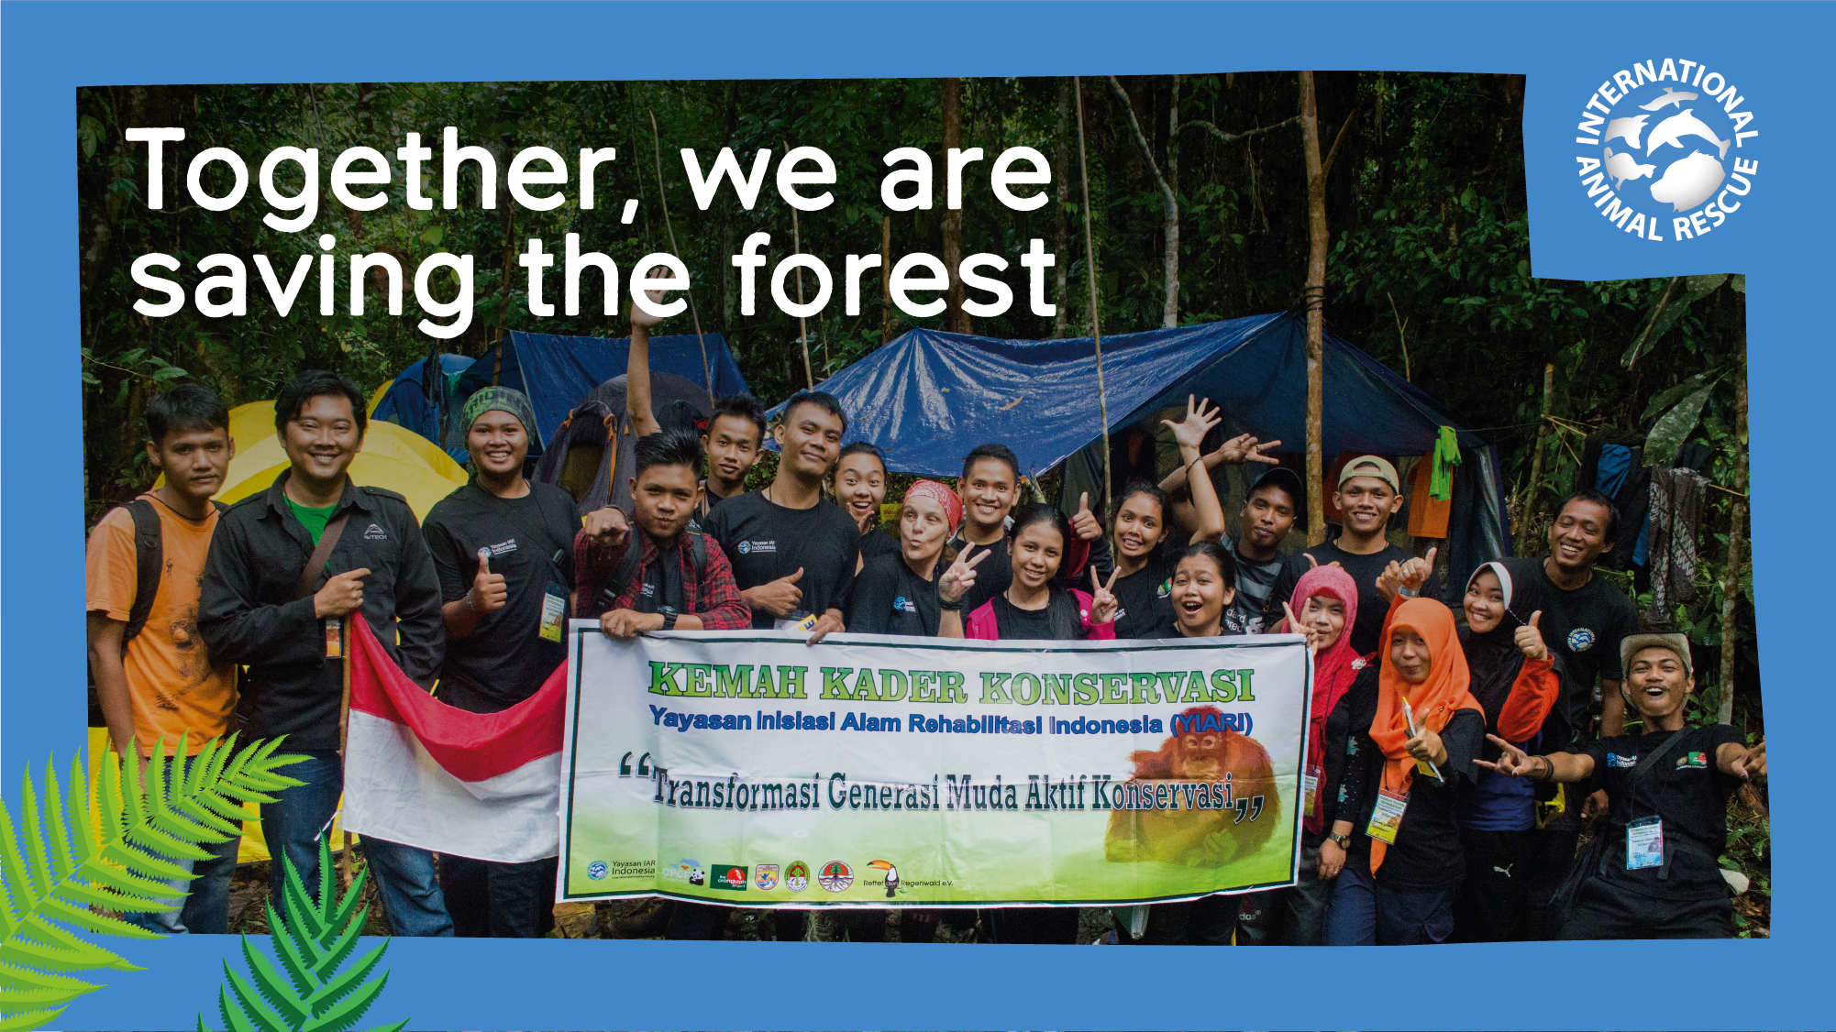
Notes:
IAR can only release orangutans back into the wild if there is enough safe forest to give them all a home.
IAR works with forest rangers and farmers to protect the rainforest in West Borneo.
Just like teachers and pupils need corridors to move from classroom to classroom, IAR helps forest owners to leave ‘corridors’ of trees that link areas of forest, so orangutans can move between each area.
IAR helps farmers to grow more food on their land, so they don’t need to cut down or burn as much forest.
IAR also visits schools and towns to help people to learn why the rainforest is important, not only for orangutans but for all the other animals that live there. They organise conservation camps like the one in the picture, that help local young people to discover why its important to save the rainforest and to learn how they can help.

Slide 17
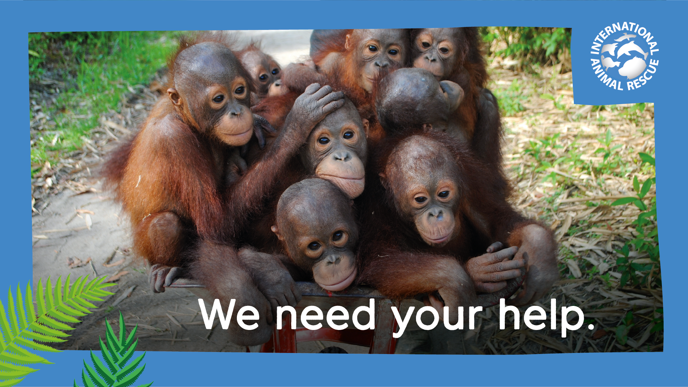
Notes:
These are just a few of the young orangutans IAR has rescued, on their way to play together at IAR’s orangutan pre-school.
But there are lots more to look after, and many more will need to be rescued from pet owners or from rainforest areas that have been cut down or burned.
*****
You can help IAR by raising money to help us rescue more orangutans in need of help, build and run more rescue centres, and do more to protect orangutans’ rainforest home by preserving the forest and helping local people to understand its importance.
If you’d like to help check out our fundraising ideas.

